Slide 1
God's Good Gifts: Called to be Stewards and Prophets

Slide 2
This session we’ll begin to:
Understand the scope, urgency, and possible solutions of the climate crisis.
Understand humanity’s effects upon nature’s systems.
Claim our role as caretakers and advocates.

Slide 3
Scripture: Job 14:7-9 Matthew 18:20 Text, Context, Next
Notes:
Breakout discussion – give one of these texts to each group.
After a few minutes’ group discussion, invite the question – what’s the implication of these texts for our Next actions?

Slide 4
Climate Change 101

Slide 5
Climate Change 101

Slide 6
Climate Change
Greenhouse Gases
Global Warming
Notes:
The focus of this presentation is to clarify the terminology, the science, and the consequences related to climate change.

Slide 7
Notes:
You have seen the news—wildfires, glaciers melting, sea level rising …

Slide 8
Notes:
intensified storms, drought and desertification,

Slide 9
Notes:
flooding that inundates property, causing economic loss and loss of life, flooding that delays or damages the planting of crops

Slide 10
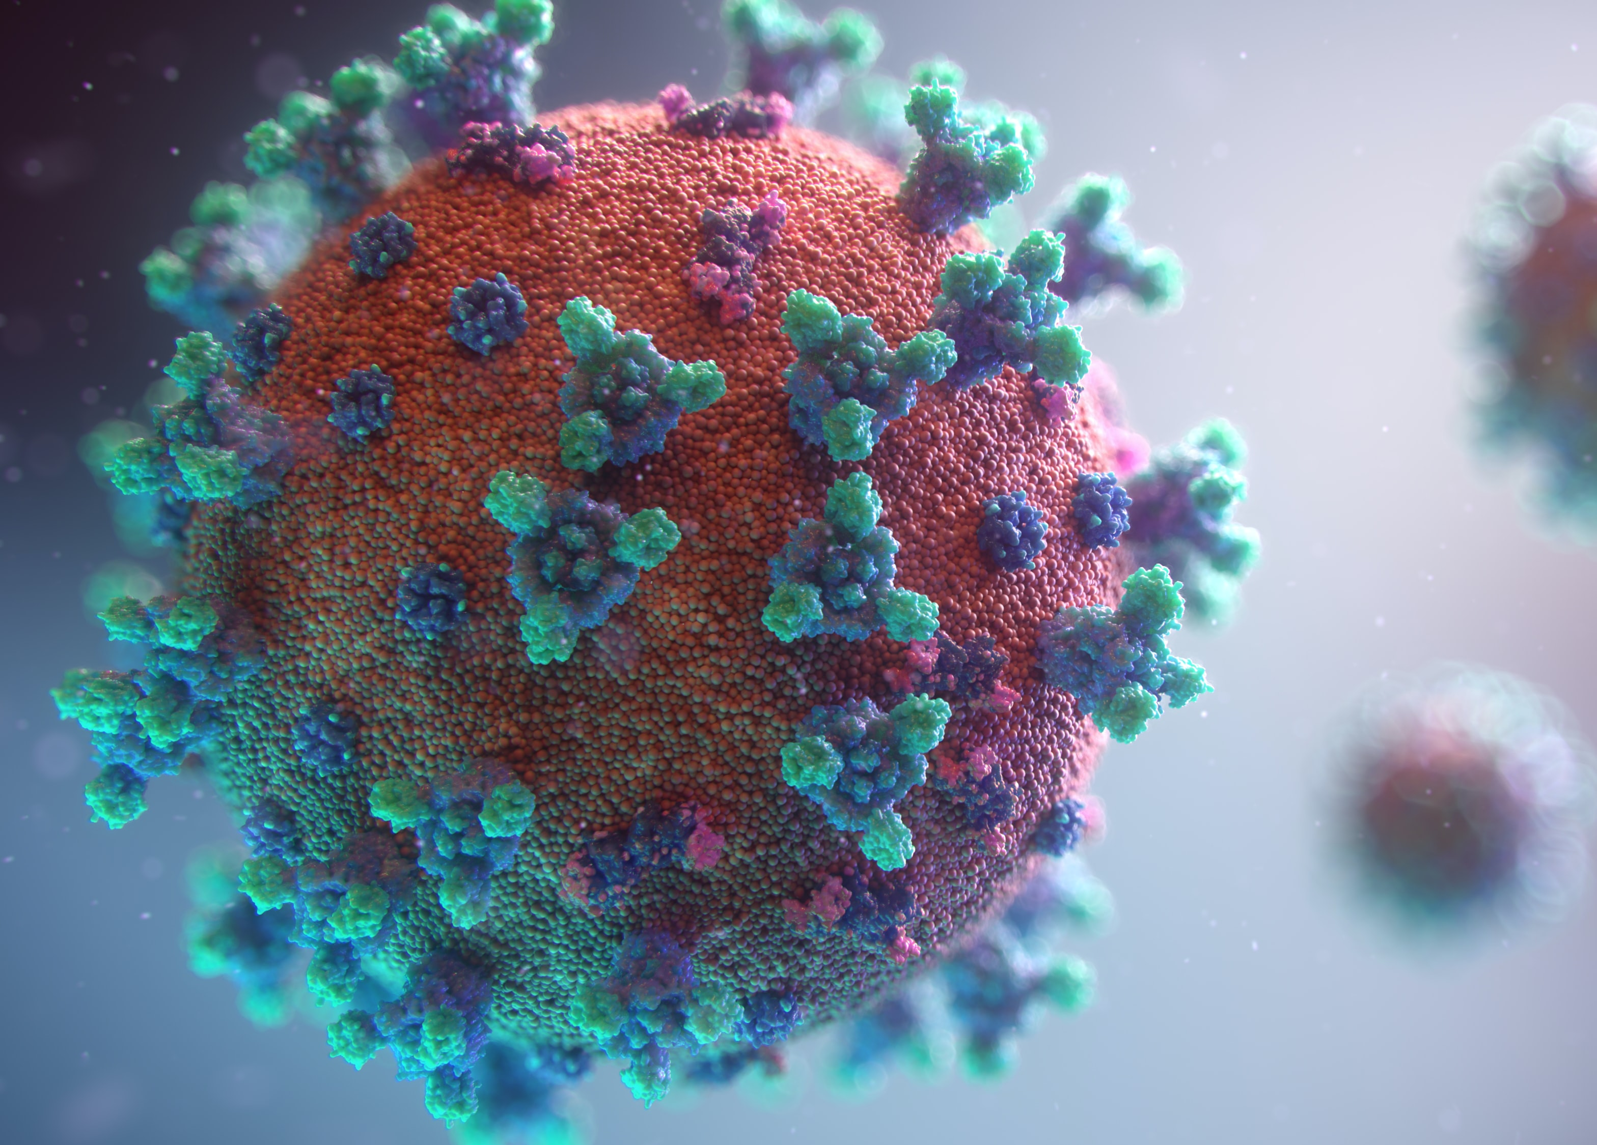
Notes:
Even the spread of new diseases

Slide 11
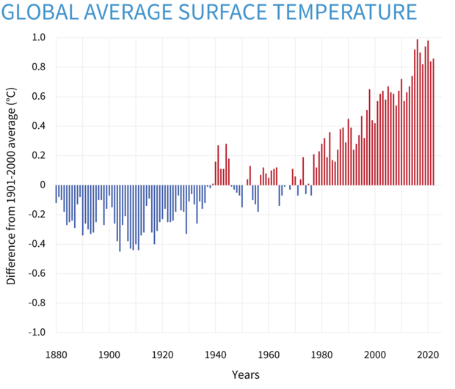
Notes:
The global climate is definitely warming. The zero line here is the global average surface temperature for the whole 20th Century, 1901-2000. Now, looking at those final eight years on the right…

Slide 12
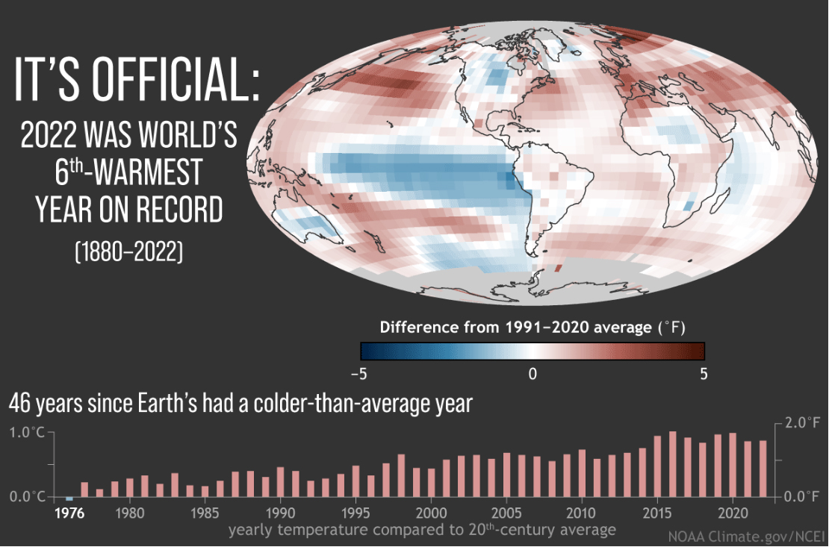
Notes:
We’ve experienced the 8 hottest years on record in the past 8 years.
You’ve heard all these things attributed to climate change or global warming, but what is that? And how can that be when we still have snow and cold weather?
So, let's look at the differences between climate and weather.

Slide 13
Climate
Imagine
Weather
Notes:
How many of you have ever had a dog?
Imagine taking a walk with a dog off leash. You may be headed in one direction, but the dog? Erratic! Zig zags! Ahead one minute and behind the next. But the dog is still basically tracking "with" you.
Think of climate as the one who is on a steady course. The dog, however, is like weather!
Another way to think of the difference is that weather is short-term and climate, long-term.

Slide 14
Virtually all climatologists across the globe agree: climate is changing, and human greenhouse gas emissions are responsible.
Notes:
You may have still have questions, but 11,000 scientists globally who study climate are in agreement.
Wikipedia footnote: Academic studies of scientific agreement on human-caused global warming among climate experts (2010–2015) reflect that the level of consensus correlates with expertise in climate science.^{[1]} A 2019 study found scientific consensus to be at 100%,^{[2]} and a 2021 study concluded that consensus exceeded 99%.^{[3]} Another 2021 study found that 98.7% of climate experts indicated that the Earth is getting warmer mostly because of human activity.^{[4]}
(Slide updated November 2023)

Slide 15
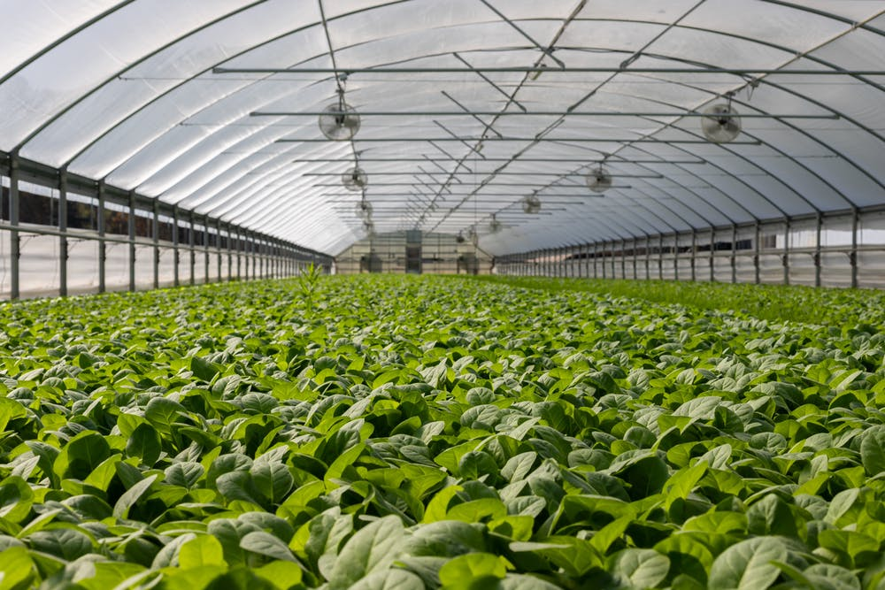
Increased Greenhouse Gases →Global Warming →Climate Change
Notes:
Let’s unpack these terms: Think of a blanket at the outer edge of Earth’s atmosphere. Kind of like this covering over the greenhouse in this photo. The blanket is made up of what are called “Greenhouse Gases.” This name has NOTHING to do with actual greenhouses! Greenhouses are good, their plants take in carbon dioxide and emit oxygen!
As in a greenhouse, they let solar heat in and hold some of it, making life on Earth possible by keeping the planet from freezing.
However, the GHGs also prevent heat from escaping from Earth. When the GHGs, like a blanket, become too heavy, the additional heat then bounces back and overheats the atmosphere and oceans, producing global warming, which then produces climate change.
Increased Greenhouse Gases lead to Global Warming, which leads to Climate Change.

Slide 16
Greenhouse Gases
Carbon Dioxide (CO₂)
Notes:
5 compouds make up GHG: 3 are significant but relatively small percentages. (Water vapor is a natural phenomenon that on its own is key to keeping our planet livable. Human contributions are: Nitrous Oxide, primarily from fertilizer, and the fluorinated gases found in our refrigerants.
The other 2 GHG are the most potent:
CO2, which comes from burning of fossil fuels—coal, oil, gas—for generating energy to power our homes, businesses, and vehicles. This element is the greatest contributor to GHG. Curbing our emissions is essential. The largest sources of emissions are transportation, buildings, building materials like steel and concrete.
With the decrease of cars and trucks on the roads during the COVID-19 worldwide shutdown, CO2 emissions dropped significantly, giving us a glimpse of what we have been missing and the hope that we can make necessary changes.

Slide 17
Methane
Notes:
The other major contributor is Methane, which is less in volume and, although it doesn’t linger as long in the atmosphere, it is much more potent molecule for molecule than CO2. Natural gas is a mix of methane with a few other hydrocarbons. Methane – that is, natural gas – escapes from oil and gas operations during fracking, pipelines, and transport.
The other sources of methane are landfills (especially food waste) and livestock (beef, especially). So, what you throw away and what you eat matters.

Slide 18
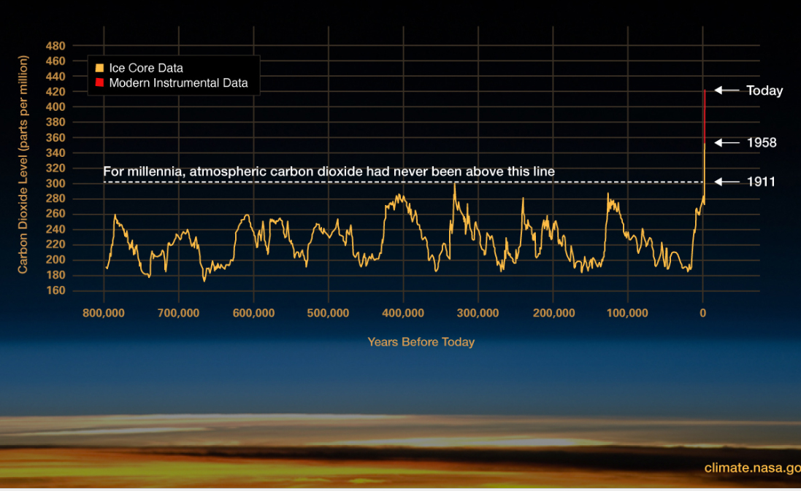
Notes:
BECAUSE THE GRAPH MAY BE HARD TO READ, TALK ABOUT THE ELEMENTS THERE—MILLENIA, CO2
NASA’s research shows the dramatic increase in GHGs in general—and of CO2 in particular— in the last 70 years.
And the upward trajectory is increasing at a much faster pace, which is cause for increasing alarm.
(Slide updated November 2023.)

Slide 19
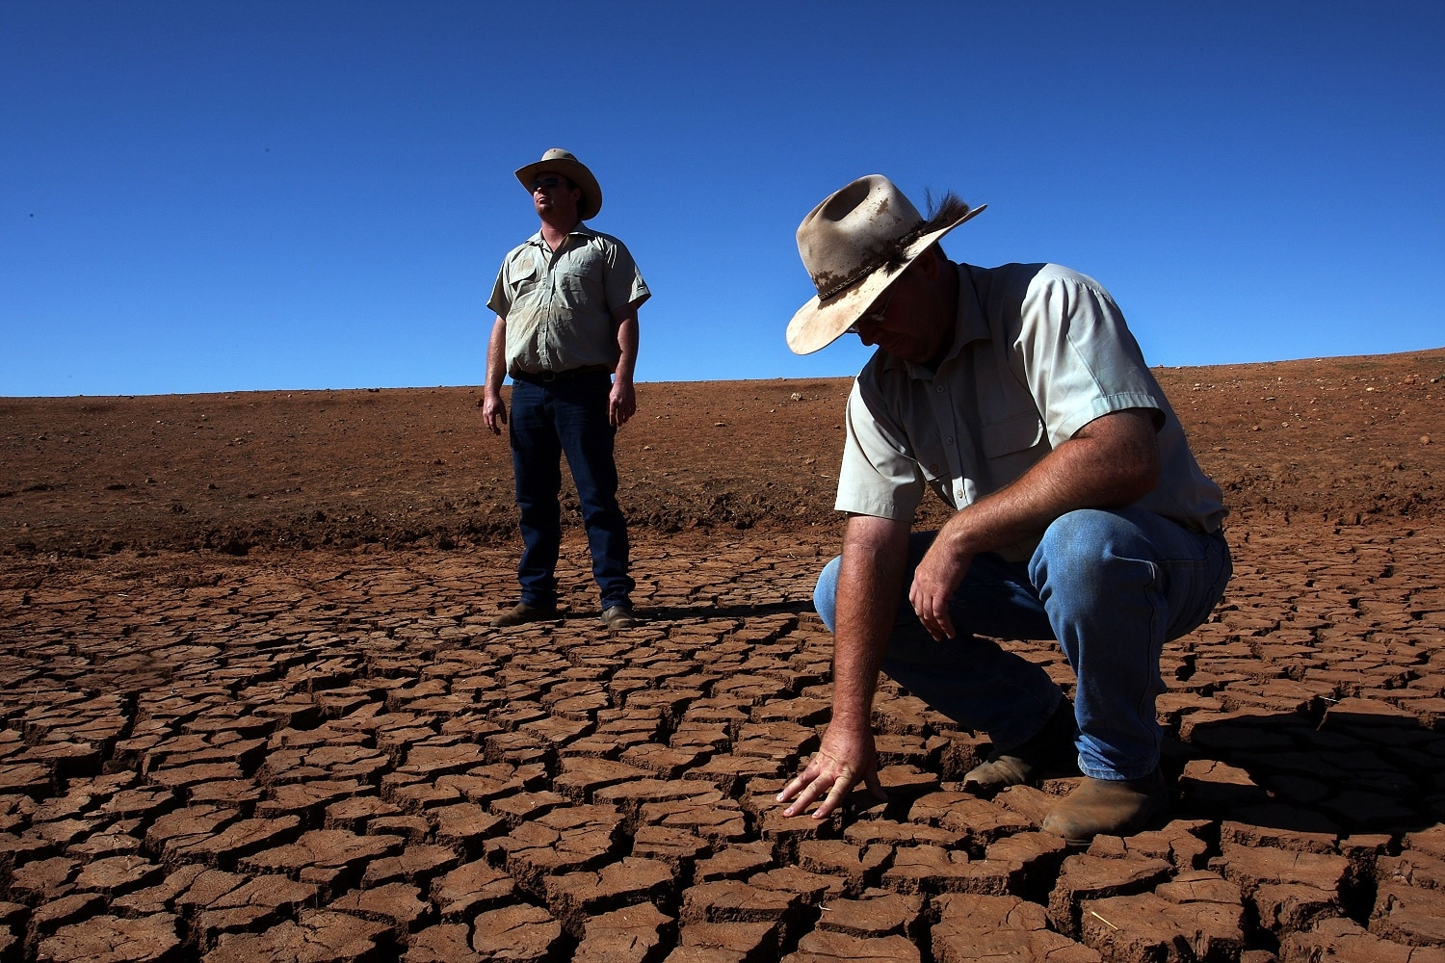
Drought
Notes:
We’ve already seen some of the consequences of global warming in the natural disasters and biodiversity losses, but climate change will also produce societal change that isn’t pretty!
The erratic weather with flooding and drought and higher temperatures interfere with being able to grow food.

Slide 20
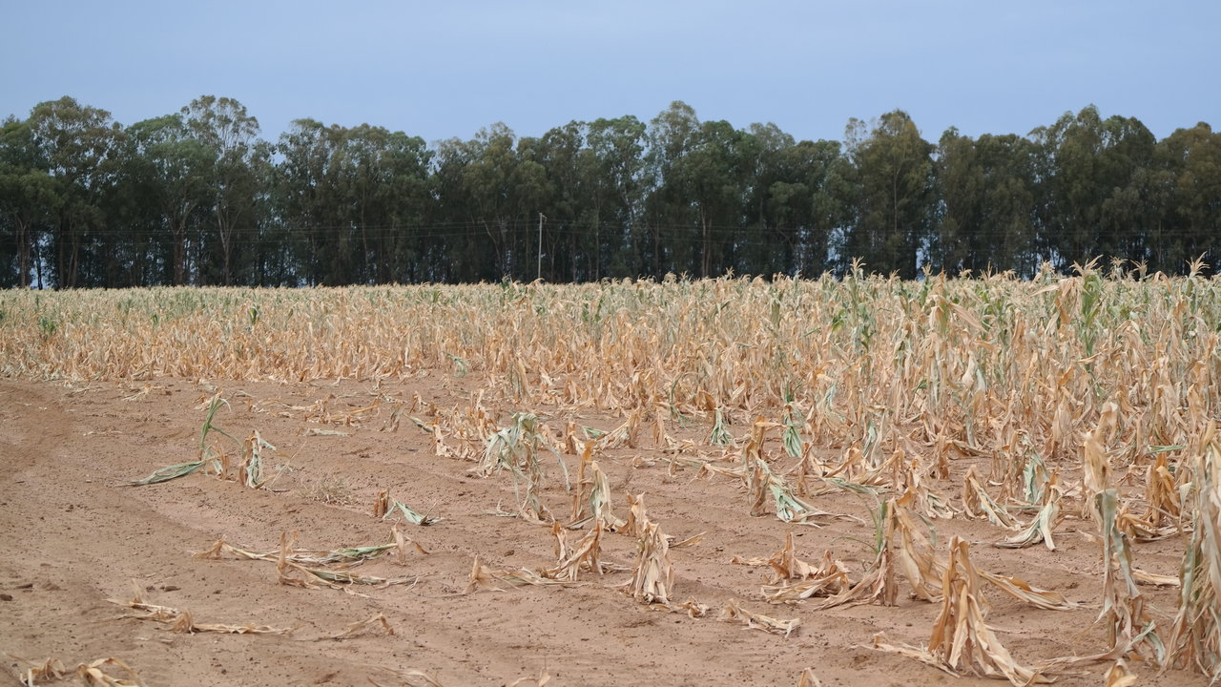
Food Scarcity
Notes:
Especially in developing countries, people who can no longer feed their families with their own farms or village cooperatives will suffer severe food shortages, malnutrition, and disease.
It gets worse.

Slide 21
Without Food Resources
Malnutrition & Disease
Mass Migration
Hoarding
Corruption Violence
Threatening life as we know it
Notes:
These "food refugees" then begin to migrate. But people in other places that have more resources will be hoarding, trying to keep their own families fed. You can see the trajectory. It’s already begun. Corruption and violence will rise.
You may have heard the statement that Global Warming poses an existential threat to civilization. The very existence of life as we know it will be adversely affected.

Slide 22
What do you do first?
Notes:
Imagine you are preparing for a hot soak in the bathtub after a long week, only to have forgotten that the water is running. You enter your bathroom and see this! What action do you take?
The best first action is to turn off the faucets. Stop the water. Then the cleanup with mops or towels can begin. Depending, drywall might have to be replaced.
Imagine using towels or ripping out drywall as a first action. How much good would that do? This is the circumstance we have in our atmosphere. An emergency caused by too much CO2. Our metaphorical bathtub is overflowing.
The first and required emergency action is to stop putting carbon dioxide into the atmosphere. There is no alternative. Less CO2 is the answer. Stop burning fossil fuel is the answer. That is the major driver of global warming and the consequences, which are untenable.
You and I can get out our spoons and bail water, but we still need the bigger action of turning off the water! Who can do that?

Slide 23
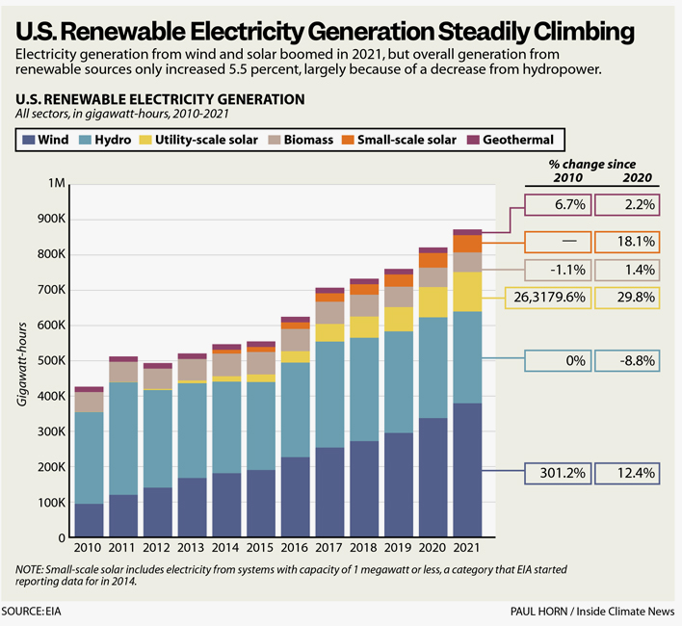
Many forces are already turning the faucet!
Especially renewables:
Small scale solar, utility scale solar, wind, geothermal –
2010-2021 (PV magazine)
Notes:
Notice the growth of wind electric generation, and both utility scale and small scale solar from 2010 to 2021! Notice that hydro power isn’t growing – for one thing, U.S. Hydro is pretty much maxed out and with climate change and drought, reservoirs are dropping. The geothermal on this chart is high-temperature, electricity generation – most geothermal energy is used with heat pumps for space heating.
(Slide updated November 2023)

Slide 24
The 15-cent/kwh rule of thumb: in Illinois
Notes:
As a “rule of thumb,” a price of 15 cents per kilowatt-hour from the utility is the point at which rooftop solar makes sense purely on a financial basis. And utility rates never go down, only up! Notice: Illinois’ average rate is now over the 15-cent mark, and rates have risen 27 percent in only 7 years – 2015 to 2022!
Of course, for communities of faith, finances aren’t the only motive. The time has passed for worrying only about “payback time” – it’s now a missional imperative that we all put our hands to turning off the faucet of carbon emissions.

Slide 25
New Administration. New Congress. New Opportunity?
Notes:
To turn off the increasing flow of greenhouse gases and the devastating consequences of the subsequent climate change, we need action from the government and from corporations at the international, national, and local levels.
But in order to bring about that change, people—lots and lots of people—must speak up or we face business as usual with the tap still on and the tub overflowing.
What we must do is called advocacy—writing, calling, signing petitions, protesting, showing up, voting, boycotting, using our economic power, making our voices heard. In other words, standing up for what is right for all in every way we can, especially by joining with others. That’s what prophets do.
As the second largest Protestant Denomination, the UMC ought to do its part.

Slide 26
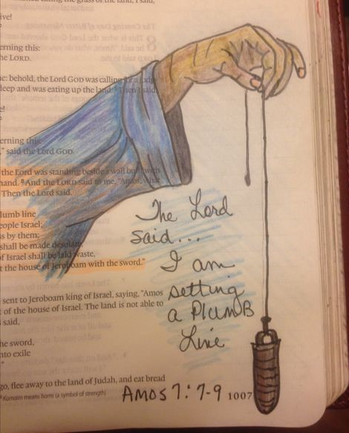
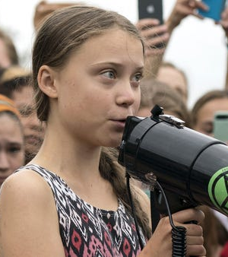
Notes:
The Book of Amos is a ferocious critique of injustice, economic inequality and pious hypocrisy. Amos, the Old Testament Prophet, had a vision from the Lord. He saw the Lord standing next to a wall holding a plumb line. The Lord said, “……I am setting a plumb line among my people Israel; I will spare them no longer… The sanctuaries of Israel will be ruined…”. Amos spoke God’s warning to Israel. King Jeroboam, on advice from his priest, kicked Amos out of Israel. Not long after, Israel was overrun by the Assyrians.
Today, passionate people are speaking up. Scientists and young people are among today’s prophets who see a new plumb line pointing to the need to address climate change now to save a livable earth. We need to understand these issues and act toward getting enough leaders in our government, unlike Jeroboam, who will pass policies that heal the land.
This “vision” calls us as United Methodists to speak up too! To love God’s people and God’s planet, we need to accept our role as prophets, as well as stewards, and make our voices heard!

Slide 27
Conversation
What questions do you have?
What image stands out in your mind?
What did you learn that was new?
What surprised or disturbed you?
What concerns do you have?

