Slide 1
Justice,
Intersectionality and Equity

Slide 2


Slide 3
Scripture Study Gen. 45:4-8a, 47:13-26

Slide 4
Scripture Study Gen. 45:4-8a, 47:13-26
Text, Context: Gen. 45:4-8a, 47:13-26
As an effort to meet the climate crisis he knew was coming,
how did Joseph’s plan work out?
Were there “unintended consequences”?

Slide 5
Scripture Study Gen. 45:4-8a, 47:13-26
Text, Context: Gen. 45:4-8a, 47:13-26
As an effort to meet the impending climate crisis, how did Joseph’s plan work out? Were there “unintended consequences”?
Next
Is there a lesson here regarding justice, intersectionality and equity?

Slide 6
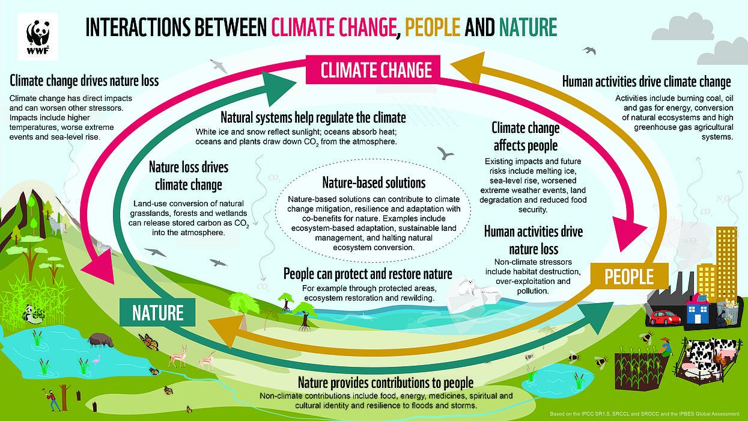
Notes:
Nothing on this planet – people, climate natural systems – nothing is independent, an island locked away from everything else. The emphasis on self-reliance in American culture has to some extent blinded us to that reality, and the extent to which other people, nature and natural systems including a stable climate make so-called self-reliance possible.

Slide 7
Centering Justice in Climate Action

Slide 8
The Multi-agency Net-Zero Covenant
We, the agencies of The United Methodist Church, pledge to achieve net-zero emissions by 2050 across ministries, facilities, operations, and investments and to leverage the gifts of our connection putting equity and justice at the center as we build a net-zero emission economy by 2050.
Simply attaining net-zero emissions could perpetuate the burden on communities that are suffering from our systems of extraction, production and waste… agencies and commissions will support a just and equitable transition that “dismantles structural barriers to racial and gender equity and builds resilient, flourishing communities.”
Notes:
Remember the Multi-agency Net-Zero Covenant and its emphasis on a just and equitable transition to a net-zero carbon emissions economy? This is a huge effort. Every action, no matter how good, may affect someone or some group negatively. Every effort must include considerations of justice, of reducing harms, and including all stakeholders in decisions.

Slide 9
Even before the Net-Zero Commitment, United Methodists were working.

Slide 10



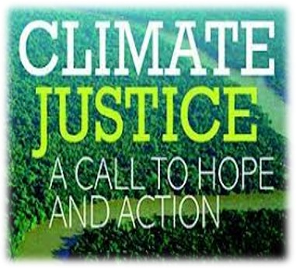
U.M.C. Creation Justice Efforts
GLOBAL MINISTRIES EARTHKEEPERS
Notes:
United Methodist efforts in creation care and creation justice are not new. They include the Social Principles, the Council of Bishops, the United Women in Faith Just Energy 4 All effort – which includes the seeds of this course - the Global Ministries Earthkeepers trainings, and the overall UMC Creation Justice movement. United Methodists are committed not only to clean energy transition and mitigation of pollution, but also to including the voices of all stakeholders, especially those most directly affected by pollution and economic disruption, in order to center justice and equity.

Slide 11





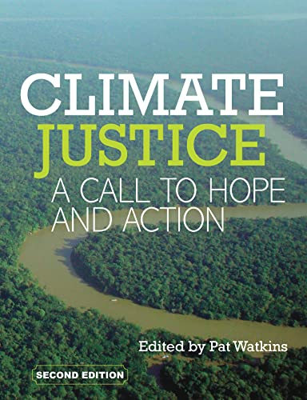
United Methodist Women, now United Women in Faith, have been on the case for years!
2021-24 Priorities:
13 Steps to Sustainability:
Ways to counter climate injustice through event planning and daily habits.
Notes:
UMW, now UWFaith, is laser-focused on mission for women and children around the world, and very aware that globally about 70% of persons experiencing poverty are women, children and youth. Its efforts have included its sustainability policies, issue priorities combatting climate change and the school-to-prison pipeline, its Just Energy 4 All campaign, and the precursors of this course.
The 13 steps, by the way, which guide the organization’s event planning, concern water, food, paper, toxins and waste, local solidarity, multigenerational inclusion, affordability, carbon footprint, accessibility, and just economic opportunities.

Slide 12
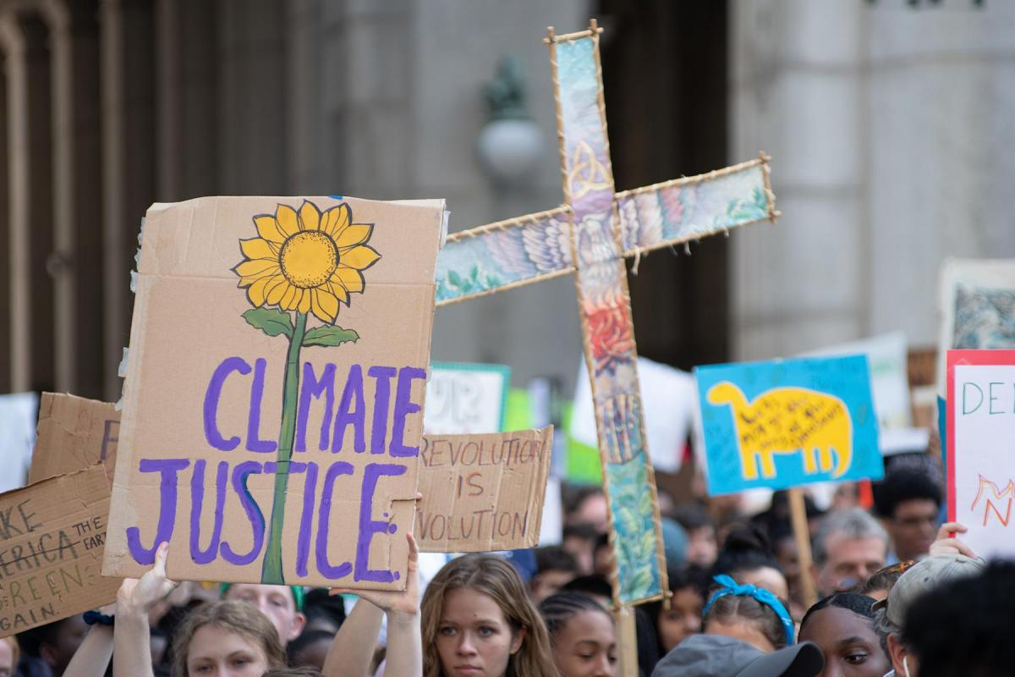
By the way - Women and youth lead in demanding change worldwide.
Notes:
The 2021 United Nations Climate Change Conference in Glasgow, COP 26, displayed clear gender and generational gaps.
Those with the power to make climate related decisions in the coming decades are of mostly an older generation and male.
Those who are the most angry about the pace of climate action are primarily of a much younger generation and female.

Slide 13
Conversation:
Have you been involved in any of these, or other environmental or climate justice movements?
Notes:
More conversation and recording

Slide 14
Council of Bishops: 2021
The bishops reaffirmed the existing Global Climate Stewardship item in the Book of Discipline (2016), Paragraph 160:D:
“…The adverse impacts of global climate change disproportionately affect individuals and nations least responsible for the emissions. We therefore support efforts of all governments to require mandatory reductions in greenhouse gas emissions and call on individuals, congregations, businesses, industries and communities to reduce their emissions.”
Notes:
In our Homework we were asked to read the 2020 proposed draft of a new Social Principles document. But this statement is already part of our official Social Principles. Meeting in 2021, the Council of Bishops endorsed the Multi-Agency Net Zero Covenant, and also pointed to this existing official stand of the church.

Slide 15
Council of Bishops: 2021
Urged annual conferences to join the Multi-Agency Net-Zero
Covenant, and take action appropriate to their settings
Promised to review its God’s Renewed Creation “to determine how to best address the intersection of climate change, poverty, racism, and colonialism. Work alongside partners, including UMW, GBCS, GBGM, Wespath, Ecumenical, and Interfaith Partners at the general Church and local community level.”
Notes:
The bishops also took these actions, and pointed to the fact that climate issues intersect with other problems, including poverty, racism and colonialism.
Colonialism: National, institutional or cultural practices that exploit less powerful communities for the benefit of more powerful people and communities, whether on an international level or a neighborhood level.

Slide 16
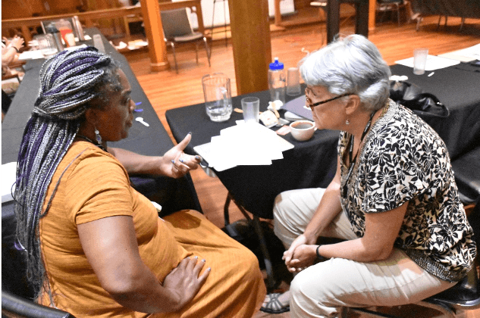
“Intersectionality” recognizes that
Disadvantaged individuals, neighborhoods, cities, and nations that may have done little or nothing to contribute to global climate change - or other pollution - are the first, and the worst, to be affected.
Where do we see that reality in
the world?
In our nation?
In our annual conference?

Slide 17
Conversation: Where has your community experienced environmental injustice?
Notes:
At this point, have a whiteboard or newsprint to list people’s experiences, or simply discuss.
There is no need to go looking at NC or FL for examples.

Slide 18
Analyzing environmental injustice
What is the injustice? Who suffers?
Where do you see intersectionality or lack of equity at play?
How might the church be a voice for change?
What can individuals do?

Slide 19
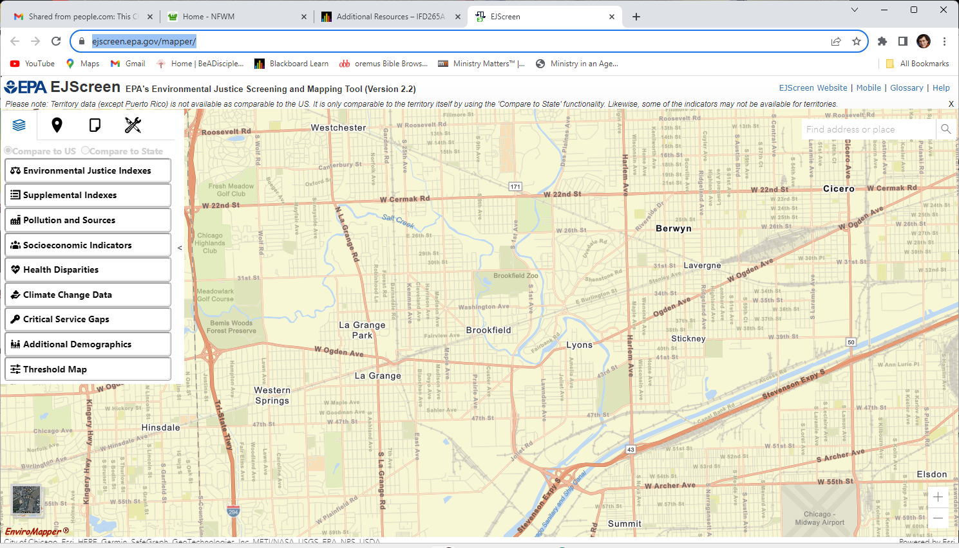
ejscreen.epa.gov/mapper
Notes:
The Environmental Protection Agency offers an amazingly detailed mapping tool that gathers huge amounts of all kinds of environmental and social data. Using it takes some skill, but it enables us to see realities that are otherwise invisible.

Slide 20
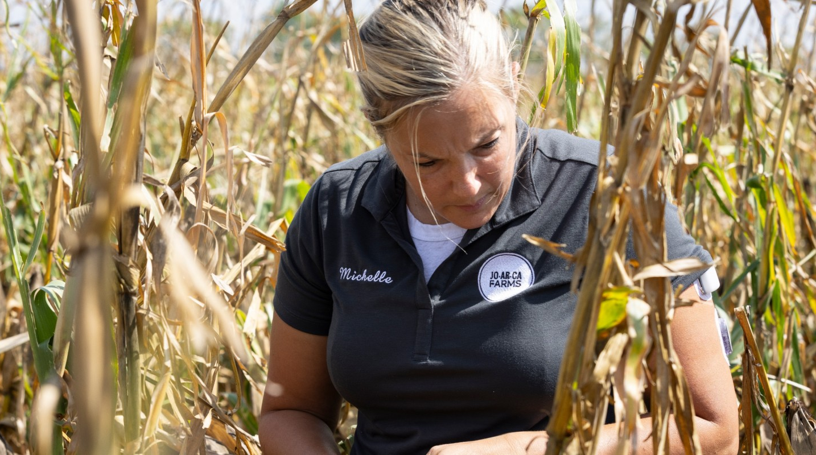
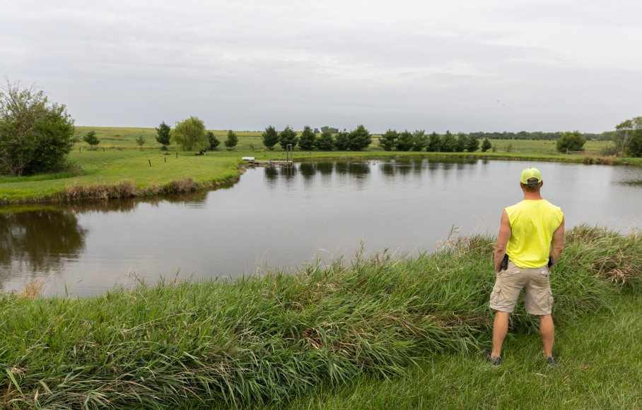
Illinois farmers’ efforts to save the soil
Michelle Carr, WBEZ photo
Jake Lieb, WBEZ photo
Notes:
If your area is primarily rural, skip the slides about Eco-House and Southside Blooms, and use the time to let your farmer lead the presentation, or create slides with information and images from the WBEZ report https://www.wbez.org/stories/illinois-family-farmers-weigh-climate-change-conservation-and-risk/b782111e-cf33-44da-8771-15e2ff7416b6

Slide 21
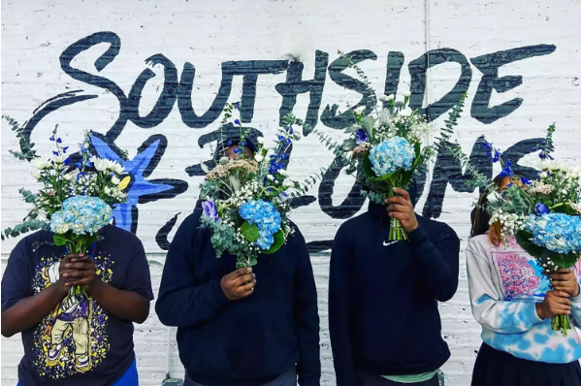
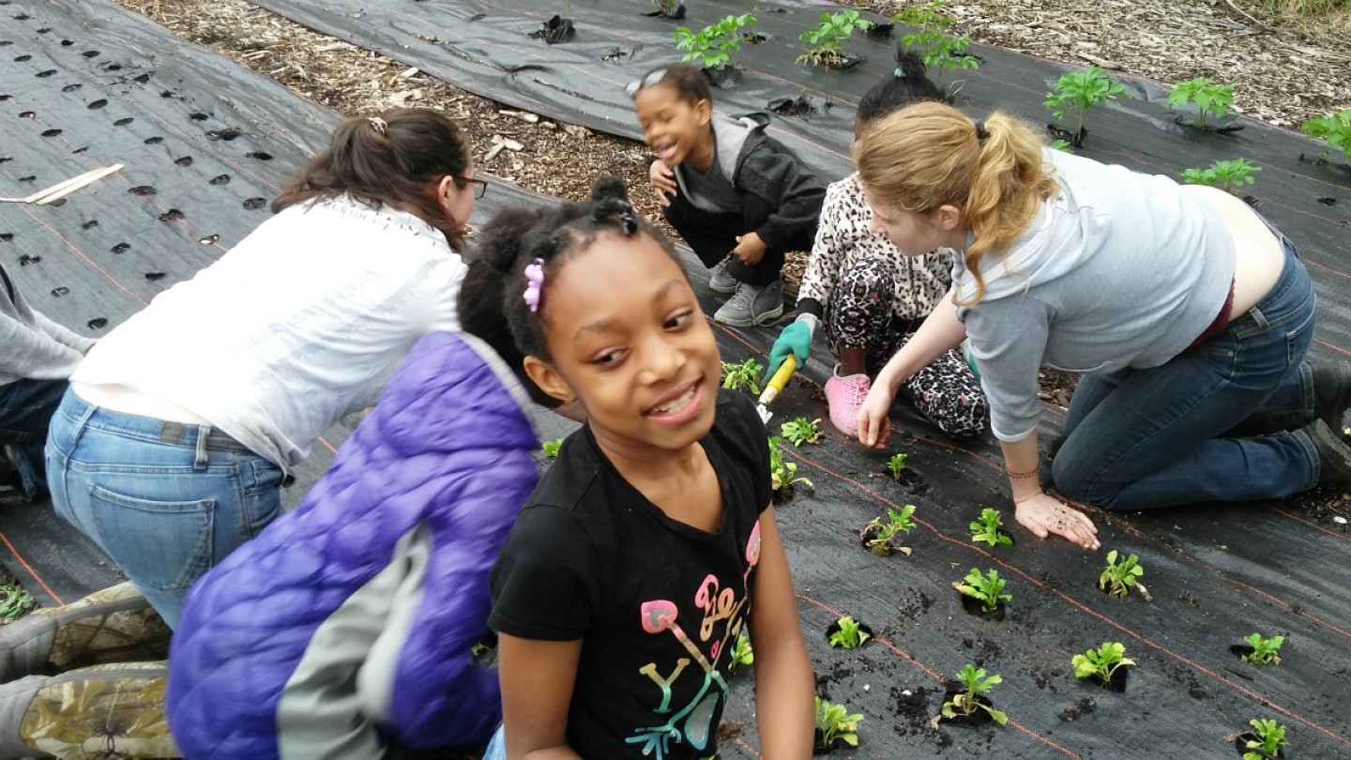
Case Study –
Chicago Eco-House and
Southside Blooms
“Using sustainability to alleviate poverty”

Slide 22
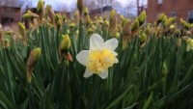

Slide 23
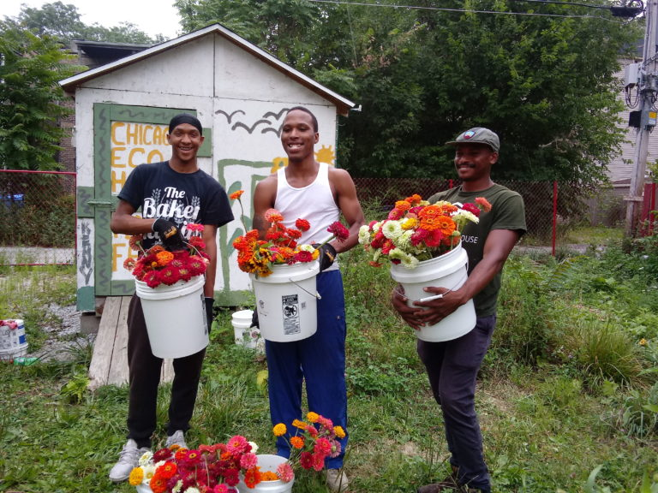
A nonprofit: Chicago Eco-House, paired with “Social Enterprise” Southside Blooms
“I believe that social enterprises are the future of business. …organizations focused on social and environmental value… With a social enterprise, the shareholders are community members. …That’s who we want to drive wealth and resources to. …
“With a social enterprise, you rely on your own income development… You have the flexibility to generate revenue like any other business but you have the heart to take care of a community like a nonprofit.”
-- Quilen Blackwell, Forbes interview,
Jill Griffin, 2022
Notes:
Chicago Eco-House also trains young folks on high-tech machinery, computers, 3-D printing, as part of its social enterprises. Young children are involved in an after-school program, and teens earn income on the farms and the flower shop Southside Blooms.

Slide 24
Conversation:
What “connecting the dots” did Quilen and Hannah have to do to create their amazing ministries?
Notes:
Why did Quilen and Hannah choose flowers instead of food for their social enterprise?
(Consider - Soil contamination, crop value, and – people need beauty too. John Wesley handed out flower seeds and encouraged window boxes. The city of Chicago maintains plantings on the streets for beauty, and because statistics show that beauty in a neighborhood reduces violence.)
One asset that may not be obvious is the very neighborhoods they choose for their farms, where gun violence and gang activity is common, and there are few healthy activities for children and youth. Why might that be an asset?

Slide 25
Connecting the dots: Food
What do we know about the food we buy, prepare, eat and throw away?
Notes:
Important statistic: Overall, 40% of food produced in the world is wasted. Food discarded in landfill decays without oxygen, producing the greenhouse gas methane. Food composted in home or city systems produces fertilizer.
So a huge way to attack climate change is to reduce food waste and compost the trimmings and leftovers!

Slide 26
CAFO: Concentrated Animal Feeding Operations
Notes:
CAFOs are industrial operations of thousands of beef cattle, hogs and poultry, kept in tightly controlled conditions, fed feeds of grain grown for the purpose, and medicated against disease or with antibiotics used to promote fast growth. The sheer numbers of animals mean that their manure has polluted the surrounding land and water. They are slaughtered in high-volume packing plants, often – as we saw in the pandemic – in unsafe conditions, and often hire trafficked workers and even children.

Slide 27
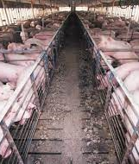
CAFOs are more likely to be sited near communities of color, and...
Communities located near hog concentrated animal feeding operations (CAFOs) had higher rates of hospital admission, emergency room visits, low birth weight infants, higher all-cause and infant mortality with more deaths due to anemia, kidney disease, tuberculosis and septicemia.
--Duke University study

Slide 28
Is a vegan or vegetarian diet the answer?

Slide 29
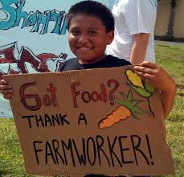

It depends…
How much water, fertilizer, pesticides does the substitute take to grow?
How much industrial processing, transport, storage?
And were there justice issues among the farmworkers involved?

Slide 30
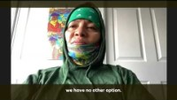

Slide 31
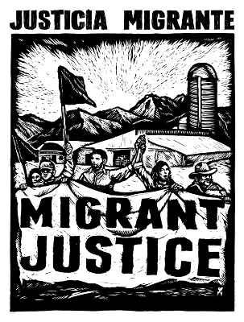



The NFWM partners with four independent certification programs:
Notes:
Look for these labels on foods.
* They bring together growers, farm workers, packers, distributors, retailers, and consumers to transform agriculture at various levels, improve the lives and working conditions of farm workers, and
enlist the (market) power of major corporate buyers to help end profiteering.

Slide 32
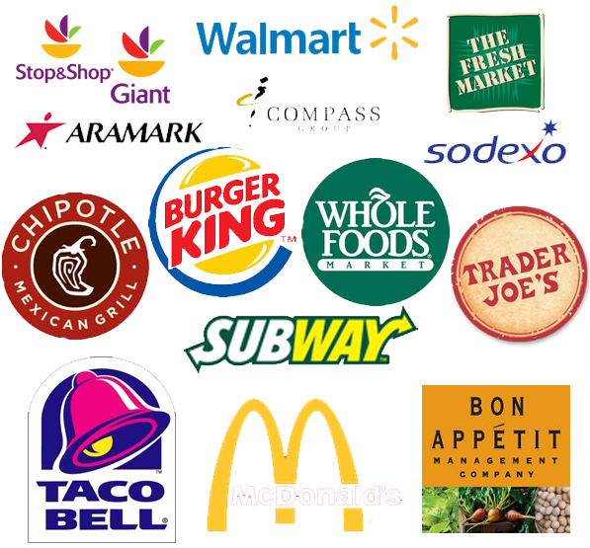
In fact, these fair food certification programs have fair food agreements with 14 major brands!
(still not Wendy’s)

Slide 33
Conversation:
What can we offer one another in terms of resources for increasing food justice, in both sources and access?

Slide 34
Break!
Next: What are local congregations doing for creation justice?

