Slide 1
Loving People and Planet in the Name of God
Session 1, Theological Grounding

Slide 2
Welcome!
Notes:
Introduce ourselves

Slide 4
Introduction
Notes:
This course is not to convince you to care for creation – you already do. We hope to share some resources and encouragement for helping our churches go deeper in caring for creation.

Slide 5
The Multi-agency Net-Zero Covenant

Slide 6
The Multi-agency Net-Zero Covenant
We, the agencies of The United Methodist Church, pledge to achieve net-zero emissions by 2050 across ministries, facilities, operations, and investments and to leverage the gifts of our connection putting equity and justice at the center as we build a net-zero emission economy by 2050.
Simply attaining net-zero emissions could perpetuate the burden on communities that are suffering from our systems of extraction, production and waste… agencies and commissions will support a just and equitable transition that “dismantles structural barriers to racial and gender equity and builds resilient, flourishing communities.”
Notes:
Net-Zero means reducing our use of fossil fuels – coal, oil, natural gas and their derivatives – so low that any remaining portion of consumption that can’t be avoided can be offset by practical measures to absorb the resulting carbon dioxide and other greenhouse emissions.

Slide 7
Northern Illinois AC Net-Zero Task Force
Notes:
This course is part of the work of the NIC Net-Zero Task Force. We are working to help members and congregations make concrete steps toward achieving Net-Zero carbon emissions, and also other efforts to live lightly on God’s good earth.

Slide 8
Facts are important, but facts are not enough. We need hearts.

Slide 9
We care for God’s creation because we’re Christians.

Slide 10
Wesleyan Quadrilateral
…and also
Scripture
Tradition
Experience
Reason
Do no harm
Do good

Slide 11
Text Context

Slide 12
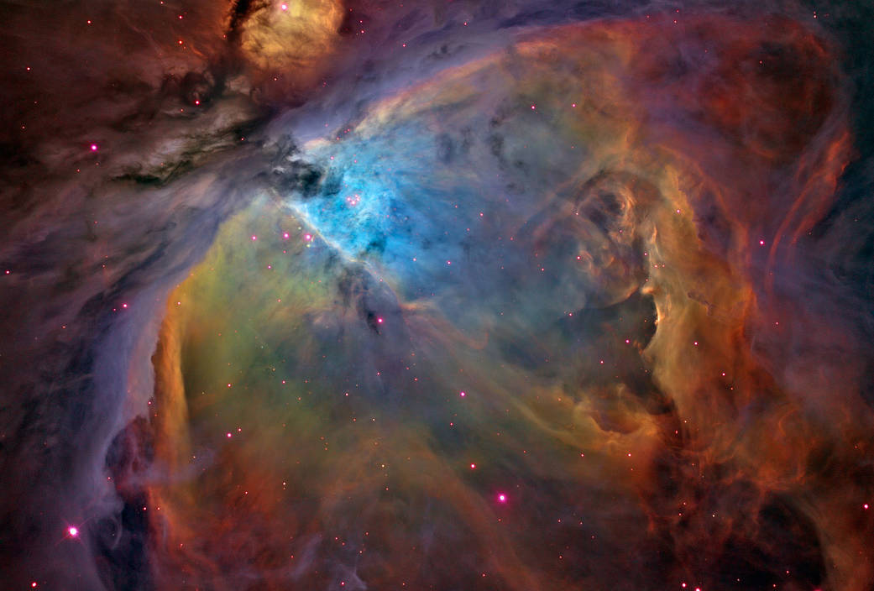
Genesis 1

Slide 13
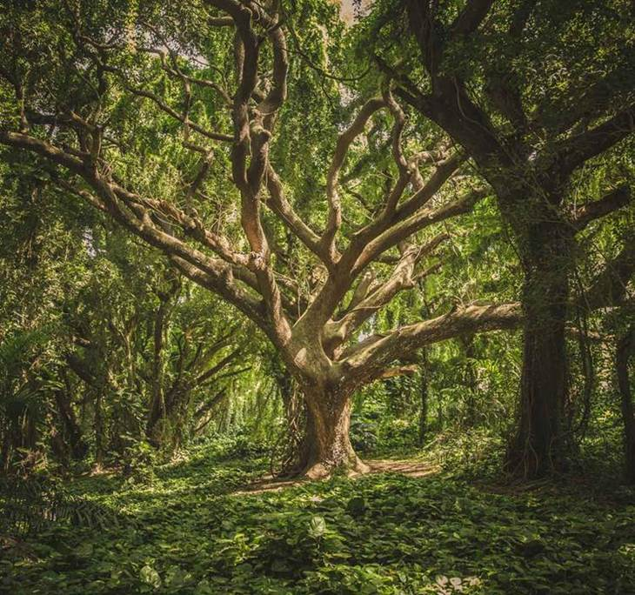
Genesis 2-3

Slide 14
Text Context Next

Slide 15
The “Next” involves our Wesleyan Quadrilateral

Slide 16
Scripture
Christians have Scripture in common.
Scripture calls us to be good stewards - responsible.
Scripture connects our relationships with God, creation, and justice.
God intends that our human response should be to pursue a simple and equitable life for all.
God has the power to change people’s hearts through Scripture.
Notes:
I rewrote Pat Watkins’ points a bit here.

Slide 17
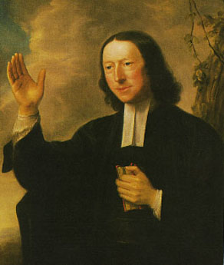
Tradition
"I believe in my heart that faith in Jesus Christ can and will lead us beyond an exclusive concern for the well-being of other human beings to the broader concern for the well-being of the birds in our backyards, the fish in our rivers, and every living creature on the face of the earth.”
John Wesley
Notes:
I wish Pat had given us a citation for this, but she didn’t.

Slide 18
Tradition
The very first part of our United Methodist Social Principles, “Community of All Creation,” emphasizes interdependence and community rather than domination.
Traditional wisdom, affirmed in our Social Principles, encourages learning from indigenous peoples to live in harmony with nature, including land use practices, and supporting action to protect water, land and air from pollution.
Notes:
Hopefully, (ha) learners will have read the social principles section in homework.

Slide 19
Tradition
The United Methodist Council of Bishops has issued a compelling statement: God’s Renewed Creation: A Call to Hope and Action.
Notes:
Hopefully also they will have read the bishops’ statement.
Pat had a thing about “Numerous theologians, including United Methodist scholars, have written about Christian environmental responsibilities.” but gave no citations, and I’m not comfortable stating this without being able to respond if challenged.

Slide 20
Experience
Experience includes the suffering of people, plants, animals—all of creation.
Experience also invites us to recognize God’s presence within the awesomeness of nature.

Slide 21
Reason
Science (how) and faith (why and for whom) are not in conflict.
God has given us minds, the ability to think as well as to act.
Scientific knowledge continues to discover how nature works, how the damage has happened and is happening, and what solutions and alternatives there are.
Notes:
Pat had experience last, to lead into the discussions of experience, but that’s generally not how the quadrilateral is cited. It will be no problem to reorder, I think.

Slide 22
Next: So what? How does your faith motivate you to care for God’s creation? How have you used the resources of your faith in creation care?
Notes:
Breakout groups

Slide 23
Group reports

Slide 24
God's Good Gifts: Called to be Stewards and Prophets
Notes:
If it’s nearly lunchtime, continue with a preview of this afternoon and Katharine Hayhoe video.

Slide 25
This afternoon we’ll begin to:
Understand the scope, urgency, and possible solutions of the climate crisis.
Understand humanity’s effects upon nature’s systems.
Claim our role as caretakers and advocates.

Slide 27
Lunch!

