Slide 1
Green My Church!
Eco-Sustainability Network of Northern Illinois Conference

Slide 2
Creation Care Affirmation of Faith

Slide 3
One: Because we find the glory of God not only in a believer’s heart but also in creation, we remember our faith in action for eco-sustainability.
Many:
We believe in God, who created the earth.
We believe that humans are part of the natural systems of creation.
We believe that the sins of humanity toward creation are not outside of God’s redeeming grace.

Slide 4
We promise to protect God’s gifts of land, air and water.
We promise to care for God’s creatures, plants and seeds.
We promise to see the natural world and the spiritual world as God’s domain and act accordingly.

Slide 5
One: May God's Word and Holy Spirit guide us in caring for creation wherever we exist as the Church.
Many:
Amen!

Slide 6
Let’s connect! What “green” activities has your church done/is doing?
Notes:
Chat with neighbor - 5 minute chat. Invite report from some about what surprising or interesting was reported, 10 mins.

Slide 7
Where is NIC now?
Bishop’s eco-sustainability task group – 7 years
2018 Annual Conference: legislation providing channels of assistance to congregations and asking us all to “go green”
Now part of NIC Board of Church and Society
Active Facebook page, Eco-Sustainability Network
Permanent website: econetnic.org blogs, resources, links, green certification

Slide 8
What did 2018 AC ask every church to do?
Form a Green Team
Have an Energy Audit
Become Styrofoam Free
Divest from Fossil Fuel

Slide 9
What did 2018 AC ask every church to do?
Conduct an energy audit Faith in Place (free) or Elevate Energy (more thorough)

Slide 10
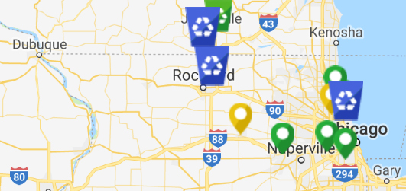
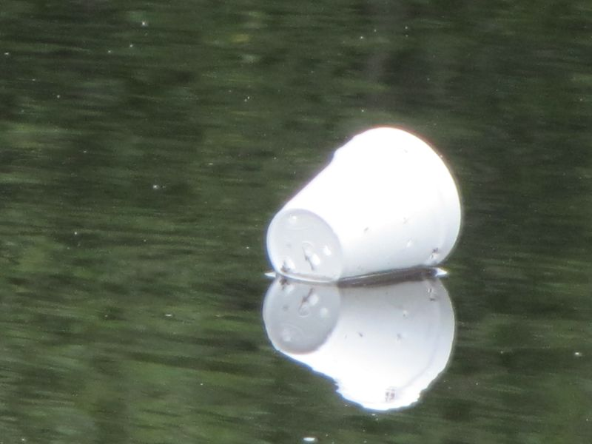
What did 2018 AC ask every church to do?
Become Styrofoam Free and assist communities in reducing and recycling

Slide 11
What did 2018 AC ask every church to do?
Divest from Fossil Fuel UM Foundation is setting up such a portfolio option
Not only for ESG reasons, but also because carbon-based energy will carry increased financial risk going forward
Notes:
CU200 means Carbon Underground 200 – 200 largest owners of fossil fuel reserves. https://fossilfreefunds.org/carbon-underground-200 ESG means “environmental, social, governance” factor ratings.

Slide 12
What did 2018 AC ask every church to do?
Form a Green Team and take one step forward – that makes sense to you – in each of seven areas:
Energy
Food
Resource Management
Water
Transportation
Toxic Chemicals
Community Outreach

Slide 13
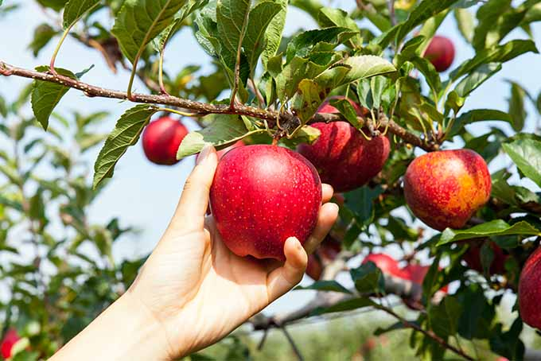
NEW! Green Church Certification – Your Reward!
Energy: LED lighting; solar on parsonage!
Resource management: Native shrub and tree sale; planted 10. PADS went compostable!
Transportation: Blessing of the Bikes! Electric Car demo.
Food: Advocate healthy Social Hour food Served Mediterranean food for event
Toxic chemicals: Published scent policy Pesticide-free lawn (with signs)
Water: Planning rain garden, Unhook downspouts
Community Outreach: Active in Interfaith Green Net, Host Green Fair, Showed movies, Certified Butterfly Garden
Example: Euclid Avenue UMC, 2017-2018
Notes:
Go for the low hanging fruit first; leverage savings into enthusiasm for bigger projects!

Slide 14
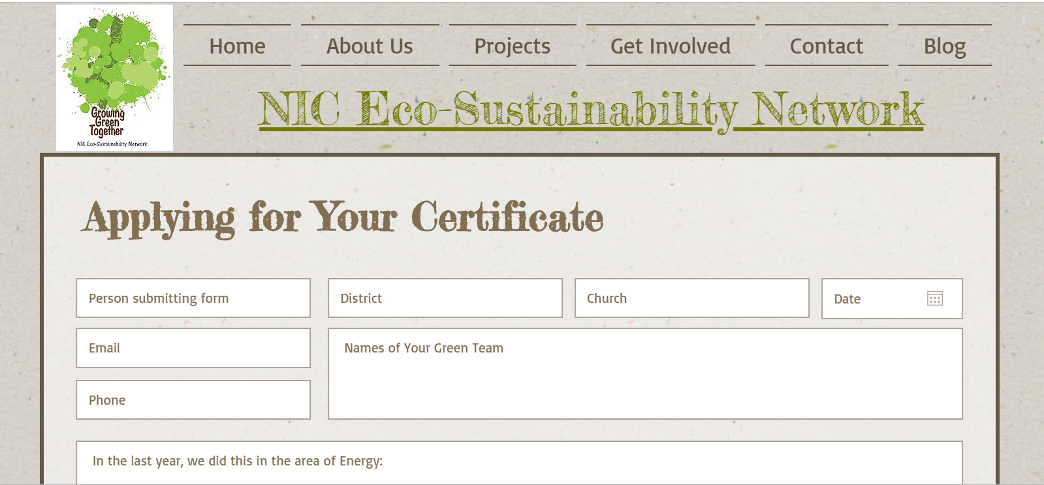
econetnic.org

Slide 15
Why?
It’s about cutting costs where possible.
It’s about shrinking our carbon footprint to care for creation and all life on earth.
It’s about our faith.
It’s about a spiritual crisis: worshiping the Creator.
It’s about evangelism.
We live green because we are followers of Jesus.
Notes:
Make the point: Many folks, especially younger persons, want to belong to a church that takes creation care seriously.

Slide 16
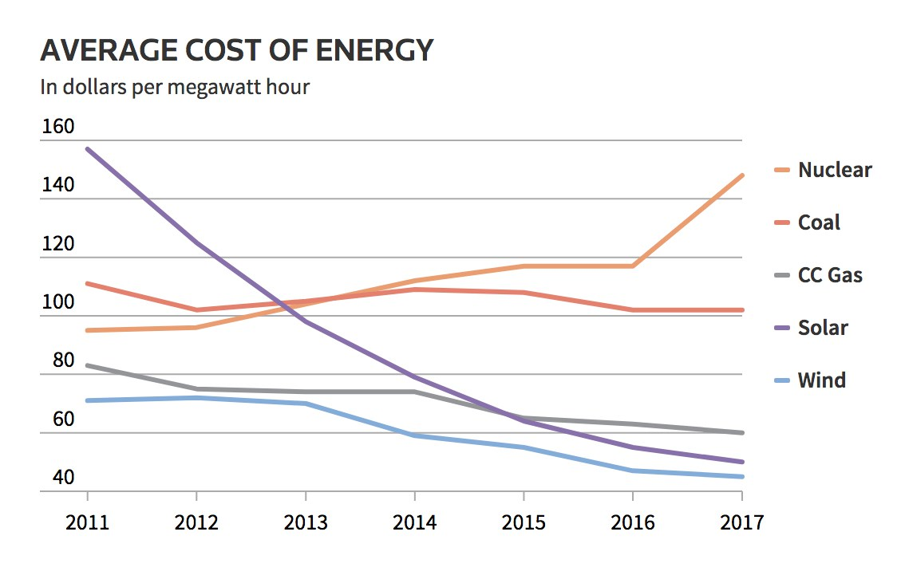
We support creation-sensitive investment because we are followers of Jesus. Fortunately, it’s also plain good business!
Reuters.com graphics, 3/9/18
Wind and Solar will even be cheaper to install, operate and maintain than natural gas by 2020, says Morgan Stanley.
Notes:
Make the point: There is much more that we can say about investment, but creation-sensitive investing has many benefits we don’t have time to detail here. One thing: You don’t have to accept all the science about climate change to want to get the best return from your investments. And the best return going forward is creation-sensitive investment, especially concerning energy of the future. The Morgan Stanley quote is from Matthew Blume’s presentation.

Slide 17
For better performance, invest carbon-free!
Between 1988 and 2013, fossil-free portfolios performed - on a par (.05% better) than their benchmarks in U.S. stocks - .31% better than benchmarks for global stocks
Over rolling 10-year periods, carbon-free portfolios did better - 68% of the time for U.S. stocks vs. benchmarks - 100% of the time for global stocks vs benchmarks
Aperio Group study, 2016, quoted from CFA Matthew Blume to NIC CFA
- A pdf of his full presentation is available at econetnic.org
Notes:
Note: The 25-year period cited included the 2008 crash.

Slide 18
For best performance, Invest Green!
For Example, the Clean 200 list (efficiency, solar, wind)
Vs S&P energy benchmark lists 7/1/16 - 2018 quarter 1
Asyousow.org
Notes:
This is from As You Sow, Clean Energy report of first 18 months of live performance.

Slide 19
Considering creation – Green living, Green church, Green investment doesn’t need to be hard!

Slide 20
Elevator Speech:
What one “low-hanging fruit” would you like to do in your congregation to “go green” – or “greener”? And why - what does this have to do with your faith?
Not should do. Not wish you could do if you had the money. One thing you would like to do now.
Share and tear!
What did you learn about faith?
Notes:
Share with a neighbor. Record on a sheet with two halves – one to take home, one with email to turn in.

Slide 21
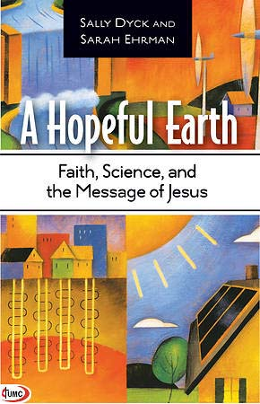
Two final recommendations:
With others, study A Hopeful Earth in your Green Team or online at BeADisciple.com
Discount code: econet
Show a One Earth Film Fest movie the week of Earth Day, April 22

Slide 22
Creation Care Affirmation of Faith

Slide 23
One: Because we find the glory of God not only in a believer’s heart but also in creation, we remember our faith in action for eco-sustainability.
Many:
We believe in God, who created the earth.
We believe that humans are part of the natural systems of creation.
We believe that the sins of humanity toward creation are not outside of God’s redeeming grace.

Slide 24
We promise to protect God’s gifts of land, air and water.
We promise to care for God’s creatures, plants and seeds.
We promise to see the natural world and the spiritual world as God’s domain and act accordingly.

Slide 25
One: May God's Word and Holy Spirit guide us in caring for creation wherever we exist as the Church.
Many:
Amen!

Slide 26
Blessings as you Go Green at your church!
Notes:
Chat with neighbor - 5 minute chat. Invite report from some about what surprising or interesting was reported, 10 mins.

