Slide 1
Introducing the Northern Illinois Conference
Net-Zero effort

Slide 2
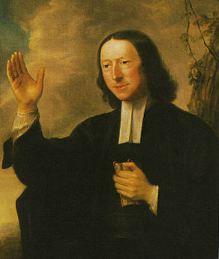
“Creation Care” is hardly a new concept to United Methodists!
"I believe in my heart that faith in Jesus Christ can and will lead us beyond an exclusive concern for the well-being of other human beings to the broader concern for the well-being of the birds in our backyards, the fish in our rivers, and every living creature on the face of the earth.”
John Wesley
Notes:
Long before the world began to realize how humans were changing the planetary systems that bring seedtime and harvest, sun and rain, John Wesley himself recognized that the coal that darkened London’s skies and the sewage in its rivers had implications for all living things. And this was about a hundred years before the mid-19th Century decades considered the serious start of the industrial age.

Slide 3

2009: Council of Bishops’ pastoral letter,
Renewing God’s Creation
“God’s creation is in crisis.
We, the Bishops of The United Methodist
Church, cannot remain silent while God’s people and God’s planet suffer. This beautiful natural world is a loving gift from God, the Creator of all things seen and unseen. God has entrusted its care to all of us, but we have turned our backs on God and on our responsibilities…”
Notes:
And before the extreme weather disasters of the last eight years, our bishops – at the request of General Conference - were calling for action.

Slide 4
The bishops’ letter calls for:
First, let us orient our lives toward God’s holy vision…
Second, let us practice social and environmental holiness…
Third, let us live and act in hope…
Notes:
There is a lot in this seven-page pastoral letter. Beginning with a call to root our lives and actions in Scripture, it goes on to specifics, including…

Slide 5
The bishops’ letter promises:
6. We pledge to measure the “carbon
footprint” of our episcopal and denominational offices, determine how to reduce it, and implement those changes. We will urge our congregations, schools, and settings of ministry to do the same.
Notes:
Promises that the bishops themselves would take action, including measuring and reducing their own carbon footprint

Slide 6
The bishops’ letter promises:
7. We pledge to provide, to the best of our ability,
the resources needed by our conferences to reduce
dramatically our collective exploitation of the planet, peoples, and communities, including technical assistance with buildings and programs: education and training: and young people’s and online networking resources.
Notes:
… and to help everyone else do the same.

Slide 7
2021:
The United Methodist
Multi-Agency
Net-Zero Commitment
Notes:
In 2021, the general agencies of the United Methodist Church began to take this language seriously.

Slide 8
We, the agencies of the United Methodist Church, pledge to achieve net-zero emissions by 2050 across ministries, facilities, operations, and investments and to leverage the gifts of our connection putting equity and justice at the center as we build a net-zero emission economy by 2050.
Simply attaining net-zero emissions could perpetuate the burden on communities that are suffering from our systems of extraction, production and waste.
That is why equity and justice are at the core of the net-zero commitment.
Notes:
But it wasn’t just a pledge to reach net-zero, that is, to so reduce carbon emissions in every part of the agencies’ operations that the small amount of unavoidable fossil carbon emissions could be offset by natural systems, such as by planting trees.

Slide 9
Council of Bishops: 2021
The bishops reaffirmed the existing Global Climate Stewardship item in the Book of Discipline (2016), Paragraph 160:D:
“…The adverse impacts of global climate change disproportionately affect individuals and nations least responsible for the emissions. We therefore support efforts of all governments to require mandatory reductions in greenhouse gas emissions and call on individuals, congregations, businesses, industries and communities to reduce their emissions.”
Notes:
The same year, the Council of Bishops endorsed the Multi-Agency Net Zero Covenant, and also pointed to this existing official stand of the church, in the 2016 Book of Discipline. .

Slide 10
Council of Bishops: 2021
Urged annual conferences to join the Multi-Agency Net-Zero
Covenant, and take action appropriate to their settings
Promised to review its God’s Renewed Creation “to determine how to best address the intersection of climate change, poverty, racism, and colonialism. Work alongside partners, including UMW, GBCS, GBGM, Wespath, Ecumenical, and Interfaith Partners at the general Church and local community level.”
Notes:
The bishops also took these actions, and pointed to the fact that climate issues intersect with other problems, including poverty, racism and colonialism.

Slide 11
So, why?
Why do the bishops use the words “climate crisis”?

Slide 12
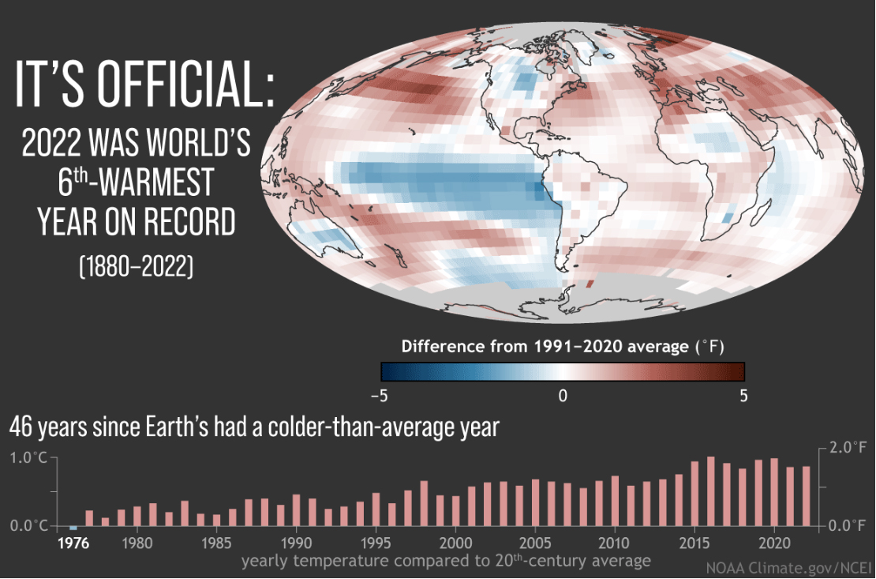
Notes:
We’ve experienced the 8 hottest years on record in the past 8 years.
But how can that be when we still have snow and cold weather?

Slide 13
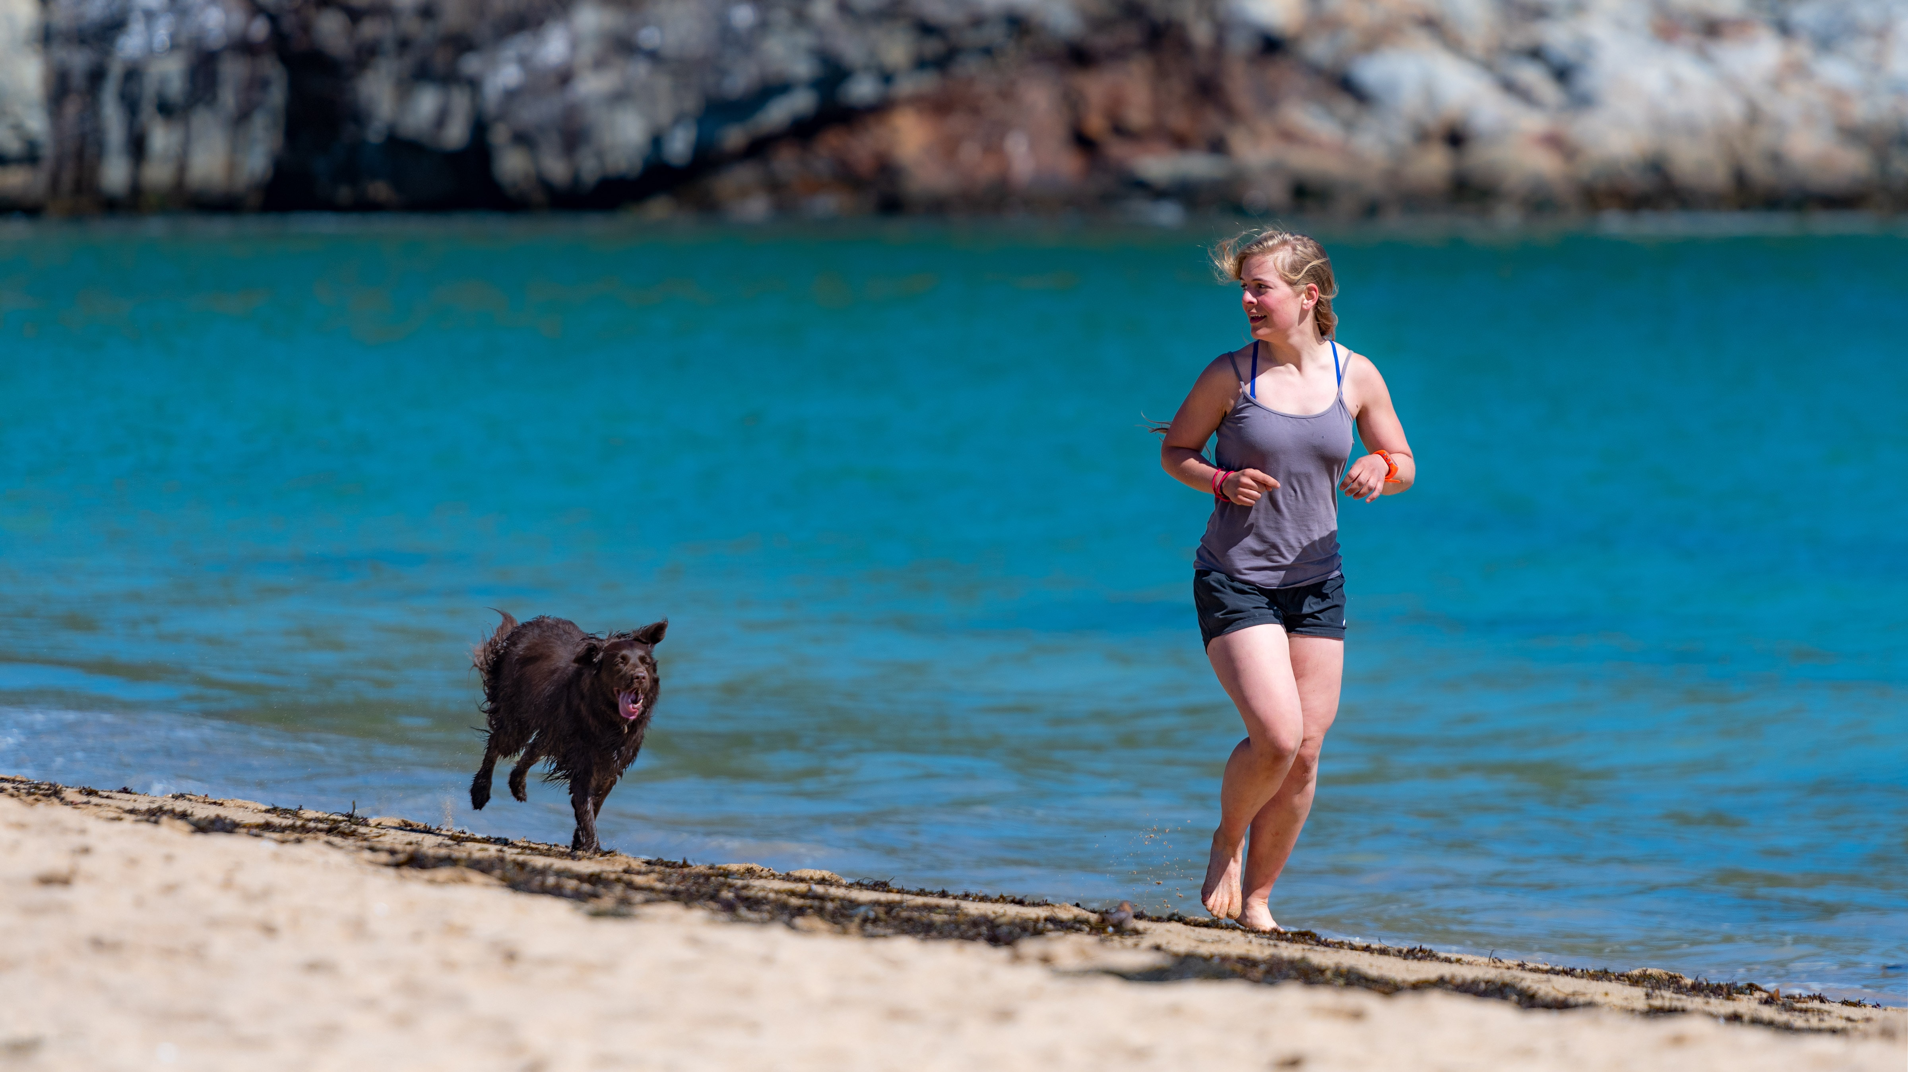
Climate
Imagine
Weather
Notes:
Imagine taking a walk with a dog off leash. You may be headed in one direction, but the dog? Erratic! Zig zags! Ahead one minute and behind the next. But the dog is still basically tracking "with" you.
Think of climate as the one who is on a steady course. The dog, however, is like weather! Another way to think of the difference is that weather is short-term and climate, long-term.

Slide 14
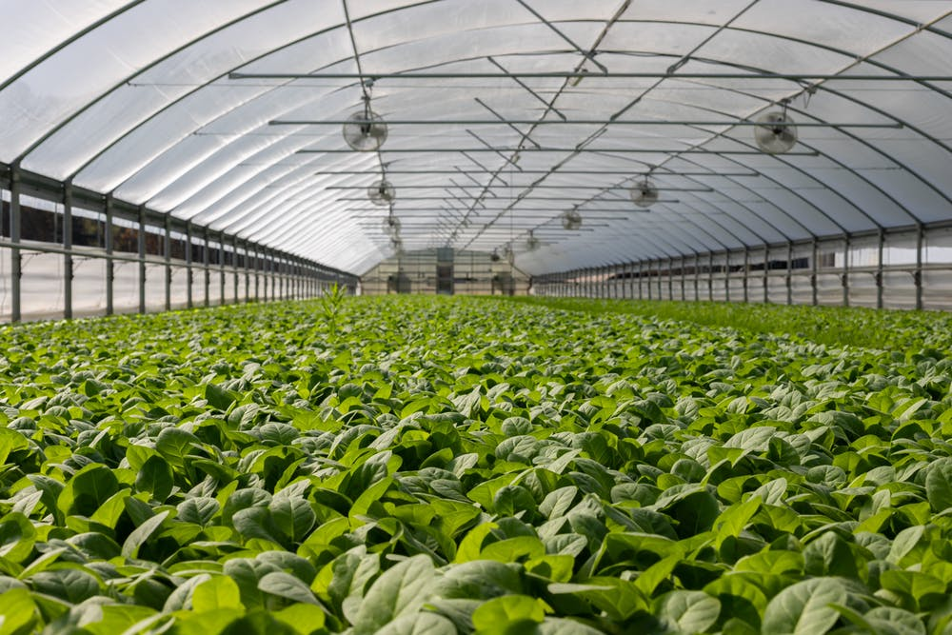
Increased Greenhouse Gases
→Global Warming
→Climate Change
Notes:
Greenhouse gases, primarily carbon dioxide, are like a blanket in Earth’s atmosphere, like the plastic on a greenhouse. Like a greenhouse roof, the gases let solar radiation in. Some of the heat from sunlight bounces back out into space, but the greenhouse gases hold a lot of it in our atmosphere, which makes life possible by keeping earth from freezing. But when the blanket of greenhouse gases becomes too heavy, the additional heat then bounces back down and overheats the atmosphere and oceans, producing global warming, which then produces climate change.

Slide 15
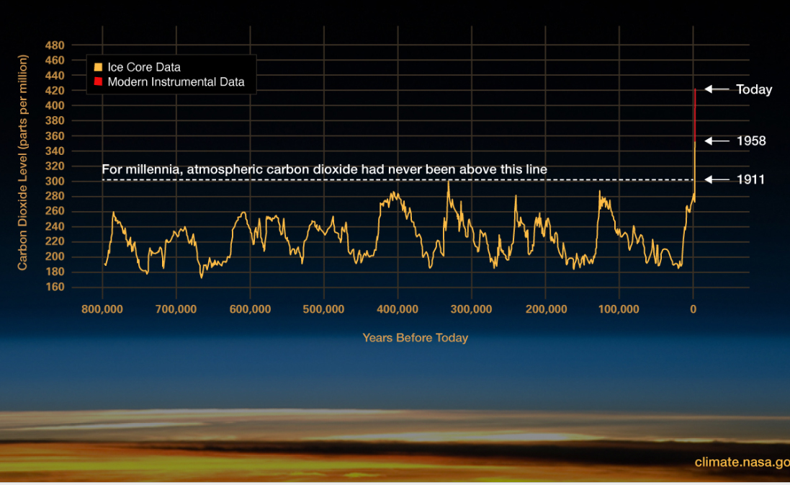
Notes:
BECAUSE THE GRAPH MAY BE HARD TO READ, TALK ABOUT THE ELEMENTS THERE—MILLENIA, CO2
NASA’s research shows the dramatic increase in greenhouse gases in general—and of CO2 in particular— in the last 70 years.
And the carbon dioxide content of our air is rising at a much faster pace than ever before in human history.

Slide 16
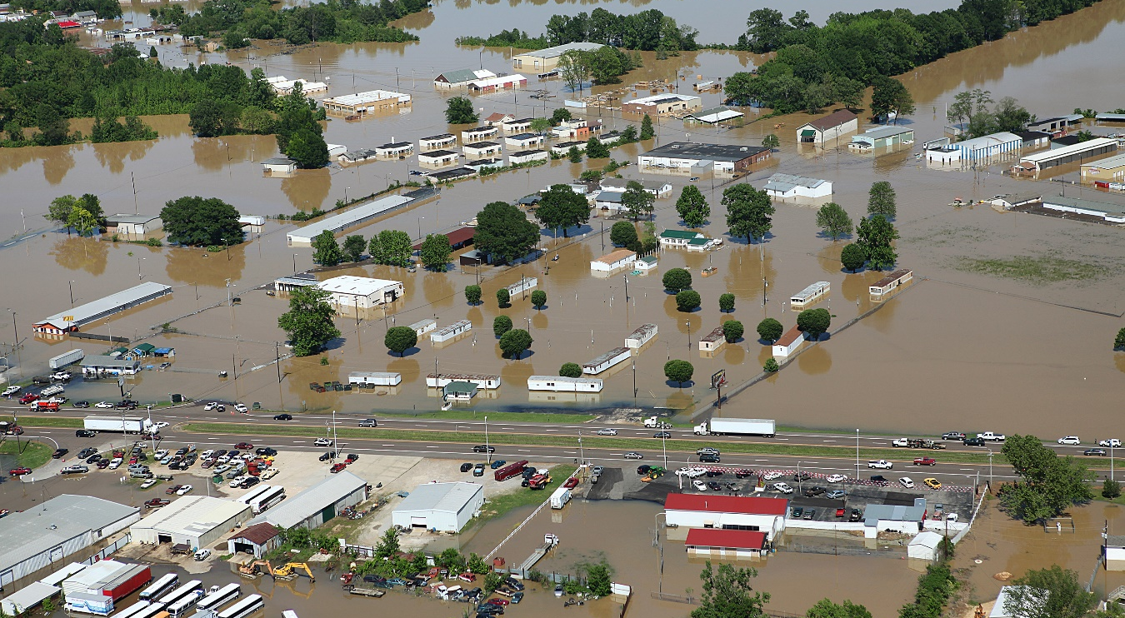
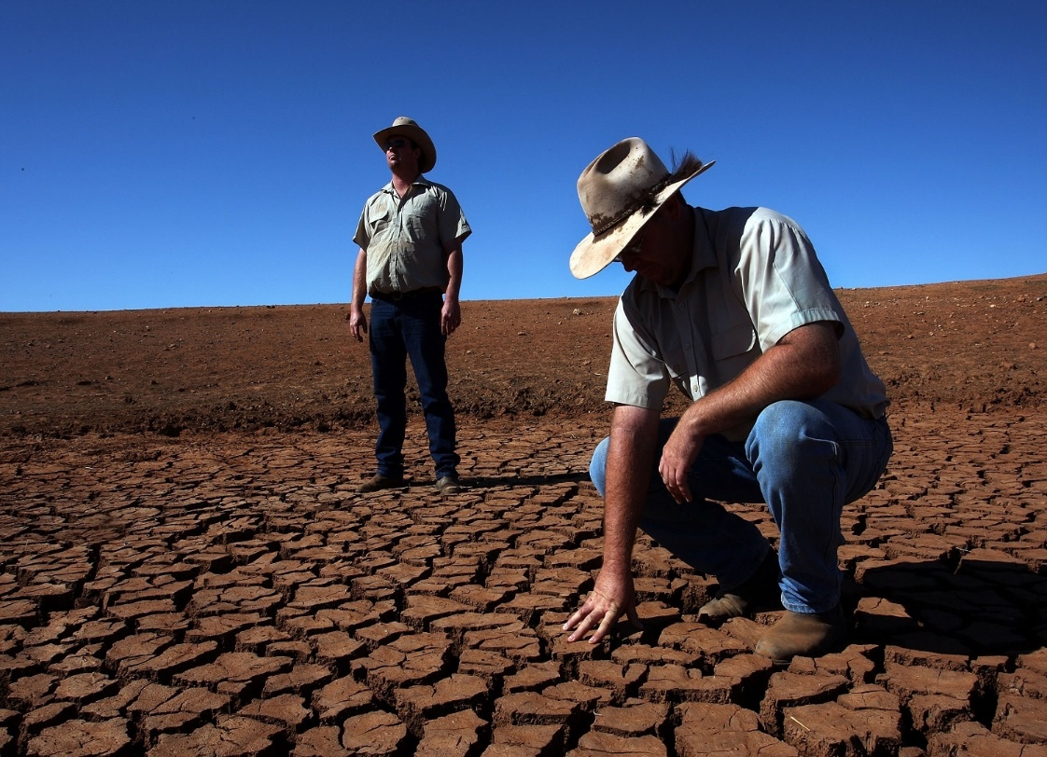
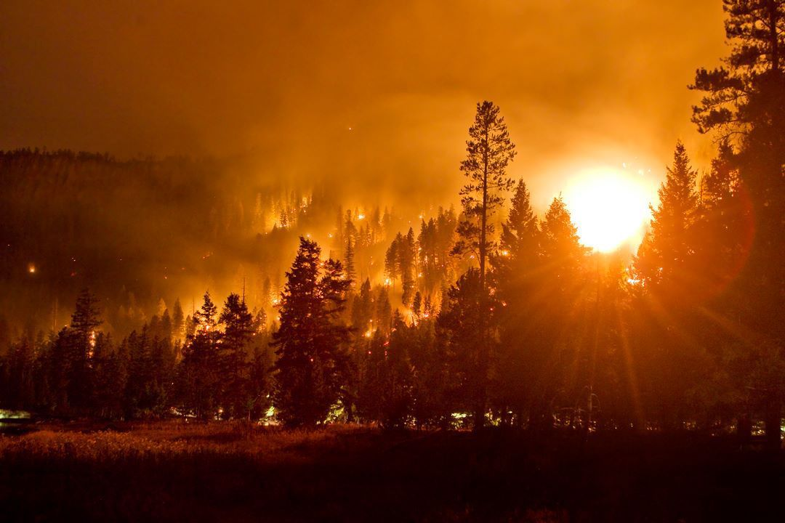
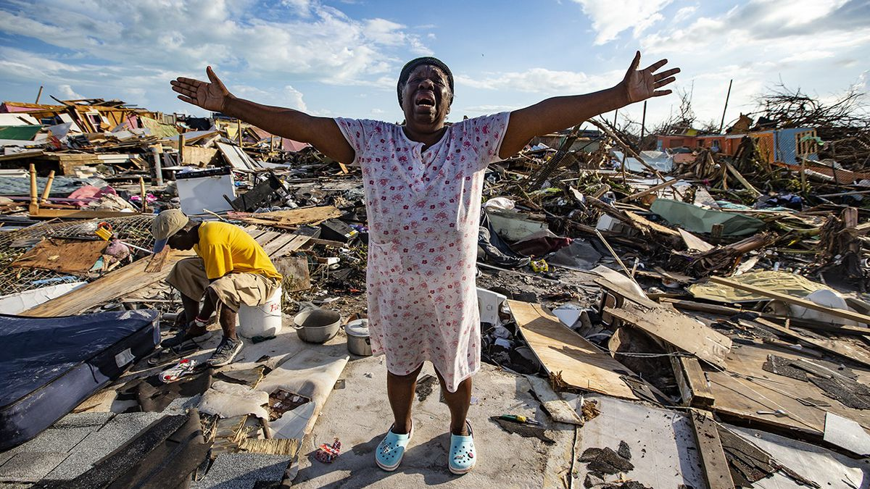
When the global average temperature rises, all extreme weather gets more extreme.

Slide 17
Conversation:
How are you – and your church –loving our neighbors in response to these disasters?
Notes:
Discussion: What are we doing now?
What might we, individually and as a church, do in the future?
If possible, collect responses on whiteboard or newsprint.

Slide 18
Next week:
Why does God call us to climate mitigation and adaptation?
What more can we do – together?

