Slide 1
Text: Luke 18:1-8: The Persistent Widow Context?

Slide 2
Conversation: Next: So what?
Notes:
Because you are here in this course, it’s virtually certain that you individually and your congregation are already working on creation care. What are the strengths you can build on? What new opportunities do you see? What might your church do?
This afternoon is all about the next – planning to involve more folks in your congregation in intentional actions toward Net-Zero carbon emissions and using all resources wisely.

Slide 3
The most important thing we can do: Talk about it. -- Dr. Katharine Hayhoe

Slide 4
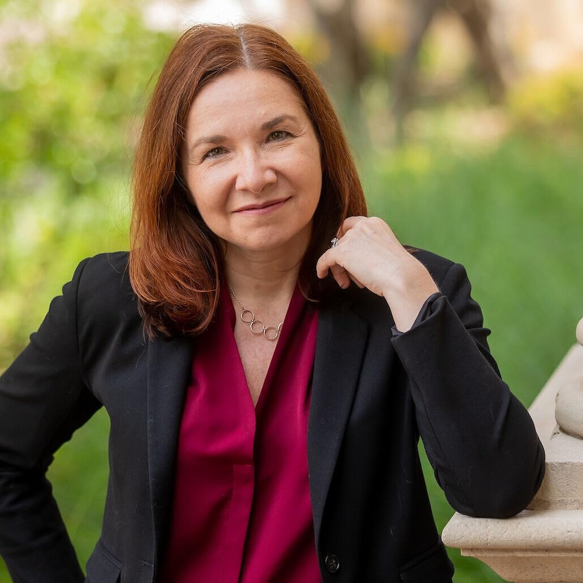
Dr. Hayhoe’s approach:
Start with conversation about interests or concerns you and your conversation partner share.
Share your concerns about how climate change – or any environment crisis – threatens those interests and concerns.
Explore together and invite possible responses.

Slide 5
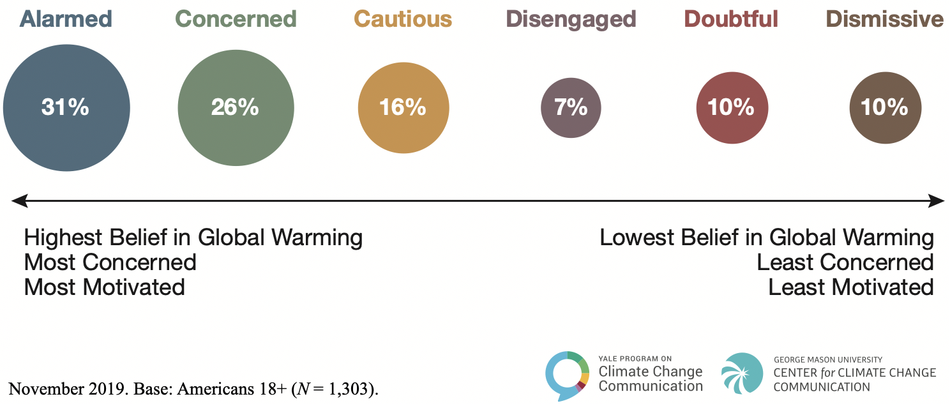
But Dr. Hayhoe notes, it doesn’t always work:
Notes:
Dr. Hayhoe notes, though: “There’s only one caveat: this approach works with everyone but dismissives. Dismissives are the 10% of the population who’ve built their identity on rejecting climate change. They’re the loudest voices and the most determined opponents – and it takes a literal miracle to change their minds. My personal definition of a dismissive is someone who, if an angel from God with brand-new tablets of stone appeared in front of them emblazoned with foot-high letters of flame saying, “global warming is real,” they would reject it. And if they reject that, then what hope do I have at changing their mind?”
But 57% in this 2019 study were already alarmed or concerned, with another 16% open to conversation, and 17% possibly open.

Slide 6
2023 Attitude Survey
53%
10%
Spring 2023
Notes:
While the Yale figures behind the previous image are from 2019, a comparable survey from the same folks shows slightly fewer among those who are “very or extremely sure global warming IS happening” – 53% down from 57% - but also fewer in the “very or extremely sure global warming is NOT happening – only half the 2019 category.
So, plenty of opportunity to talk about it, and more each year.

Slide 7
Conversation: How have you used this approach to talk about creation care?

Slide 8
But if we’re ready to do more than talk – let’s plan!

Slide 9
Planning Tool 2: SMARTIE

Slide 10
Planning tool 2: SMARTIE goals
Specific | Be as precise as possible.
Measurable | What can you quantify?
Attainable | Is it possible?
Relevant | Is it closely tied to your mission?
Time-Limited | Put a date on it!
Inclusive | Is any stakeholder left out?
Equitable | Are the actions and consequences just?
Notes:
Now that we have a glimmer of possibility with the SWOT analysis tool, let’s get serious about a plan. Get together with one or two partners and start roughing out an actual plan that you can put into action in your congregation.

Slide 11
Sharing our SMARTIE plans!

Slide 12
Notes:
12-minute video – if you have time, show this video.

Slide 13
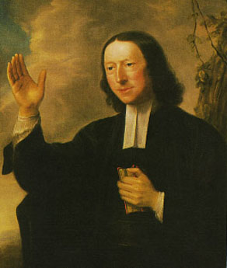
“We are now God’s stewards. We are indebted to him for all we have. . . We are not at liberty to use what God has lodged in our hands as we please, but as God pleases, who alone is the possessor of heaven and earth and the Lord of every creature. . .
[God] entrusts us with [this world’s goods] on this express condition, that we use them only as our Master’s goods, and according to the particular directions which he has given us in his Word.”
Notes:
Let’s read together an excerpt from John Wesley’s sermon on the Good Steward.

Slide 14
Amen!

